Slide 1
IE 340/440
PROCESS IMPROVEMENT
THROUGH PLANNED EXPERIMENTATION
Two Sample Tests with Numerical Data
Dr. Xueping Li
University of Tennessee

Slide 2
Chapter Topics
Comparing Two Independent Samples
  Independent samples Z test for the difference in two means
  Pooled-variance t test for the difference in two means
F Test for the Difference in Two Variances
Comparing Two Related Samples
  Paired-sample Z test for the mean difference
  Paired-sample t test for the mean difference

Slide 3
Chapter Topics
(continued)
Wilcoxon Rank Sum Test
  Difference in two medians
Wilcoxon Signed Ranks Test
  Median difference

Slide 4
Comparing Two Independent Samples
Different Data Sources
  Unrelated
  Independent
    Sample selected from one population has no effect or bearing on the sample selected from the other population
Use the Difference between 2 Sample Means
Use Z Test or Pooled-Variance t Test

Slide 5
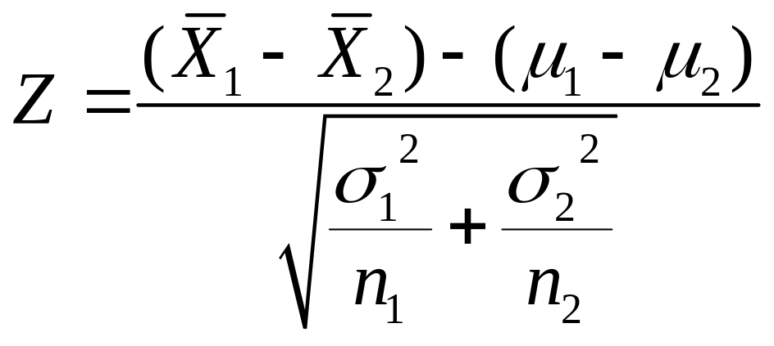
Independent Sample Z Test (Variances Known)
Assumptions
  Samples are randomly and independently drawn from normal distributions
  Population variances are known
Test Statistic

Slide 6
Independent Sample (Two Sample) Z Test in Excel
Independent Sample Z Test with Variances Known
  Tools | Data Analysis | Z test: Two Sample for Means

Slide 7
Pooled-Variance t Test (Variances Unknown)
Assumptions
  Both populations are normally distributed
  Samples are randomly and independently drawn
  Population variances are unknown but assumed equal
  If both populations are not normal, need large sample sizes

Slide 8
Developing the Pooled-Variance t Test
Setting Up the Hypotheses
H₀: μ ₁ = μ ₂ H₁: μ ₁ ≠ μ ₂
H₀: μ ₁ -μ ₂ = 0 H₁: μ ₁ - μ ₂ ≠ 0
Two Tail
OR
H₀: μ ₁ ≤ μ ₂ H₁: μ ₁ > μ ₂
H₀: μ ₁ - μ ₂ ≤ 0 H₁: μ ₁ - μ ₂ > 0
Right Tail
OR
H₀: μ ₁ ≥ μ ₂
H₀: μ ₁ - μ ₂ ≥ 0 H₁: μ ₁ - μ ₂ < 0
Left Tail
OR
H₁: μ ₁ < μ ₂

Slide 9
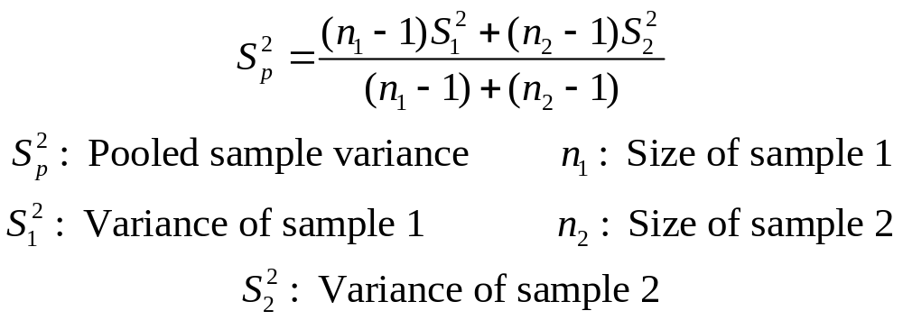
Developing the Pooled-Variance t Test
(continued)
Calculate the Pooled Sample Variance as an Estimate of the Common Population Variance

Slide 10
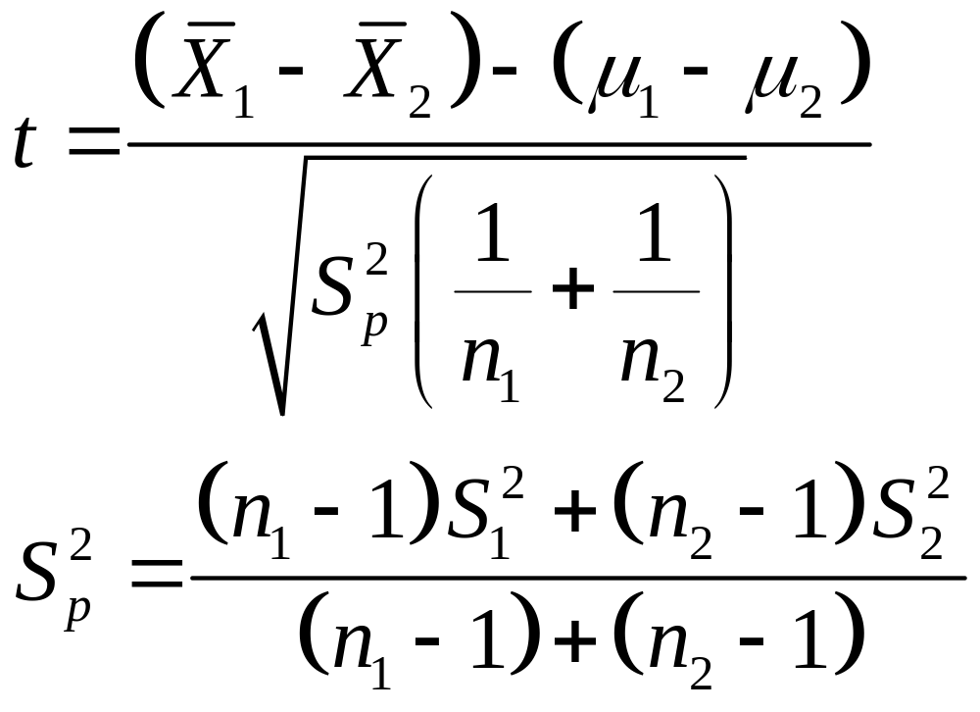
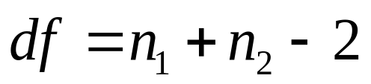
Developing the Pooled-Variance t Test
(continued)
Compute the Sample Statistic
Hypothesized difference

Slide 11
Pooled-Variance t Test: Example
You’re a financial analyst for Charles Schwab. Is there a difference in average dividend yield between stocks listed on the NYSE & NASDAQ? You collect the following data:
NYSE NASDAQ
Number 21 25
Sample Mean 3.27 2.53
Sample Std Dev 1.30 1.16
Assuming equal variances, is
there a difference in average
yield (α = 0.05)?
© 1984-1994 T/Maker Co.

Slide 12
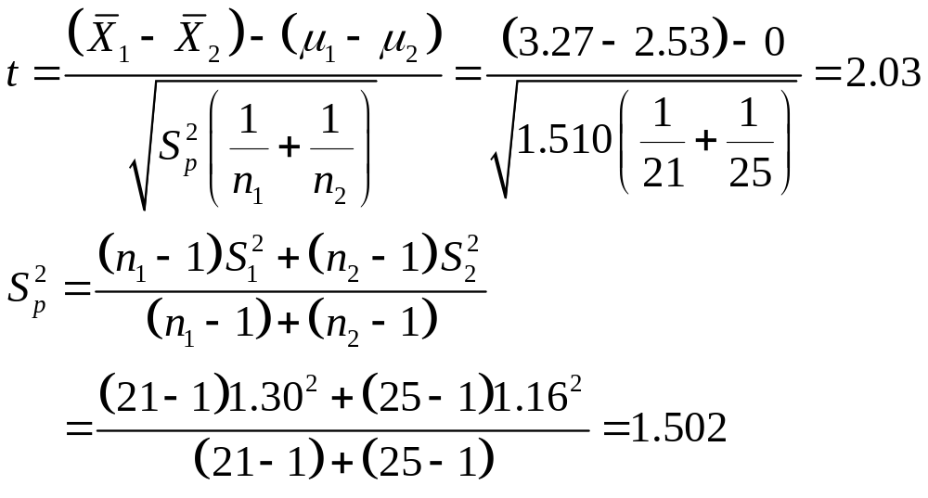
Calculating the Test Statistic

Slide 13
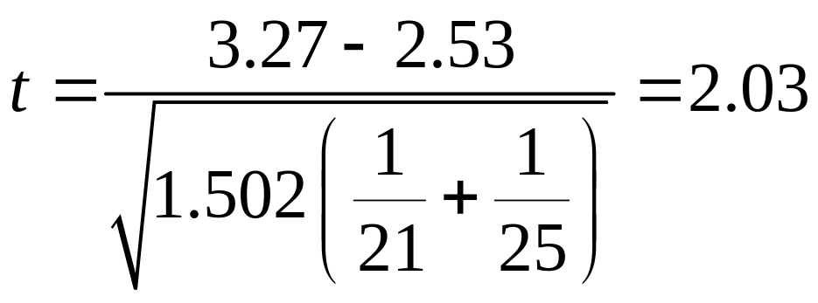
Solution
H₀: μ₁ - μ₂ = 0 i.e. (μ₁ = μ₂)
H₁: μ₁ - μ₂ ≠ 0 i.e. (μ₁ ≠ μ₂)
α = 0.05
df = 21 + 25 - 2 = 44
Critical Value(s):
Test Statistic:
Decision:
Conclusion:
Reject H
Reject H
Reject at α = 0.05.
0
0
.025
.025
There is evidence of a difference in means.
-2.0154
0
2.0154
t
2.03

Slide 14
p -Value Solution
(p-Value is between .02 and .05) < (α = 0.05) Reject.
p-Value
2
is between .01 and .025
Reject
Reject
α
2
=.025
0
Z
-2.0154
2.0154
2.03
Test Statistic 2.03 is in the Reject Region

Slide 15
Pooled-Variance t Test in
PHStat and Excel
If the Raw Data are Available:
  Tools | Data Analysis | t Test: Two-Sample Assuming Equal Variances
If Only Summary Statistics are Available:
  PHStat | Two-Sample Tests | t Test for Differences in Two Means...

Slide 16

Solution in Excel
Excel Workbook that Performs the Pooled- Variance t Test

Slide 17
Example
You’re a financial analyst for Charles Schwab. You collect the following data:
NYSE NASDAQ
Number 21 25
Sample Mean 3.27 2.53
Sample Std Dev 1.30 1.16
You want to construct a 95% confidence interval for the difference in population average yields of the stocks listed on NYSE and NASDAQ.
© 1984-1994 T/Maker Co.

Slide 18
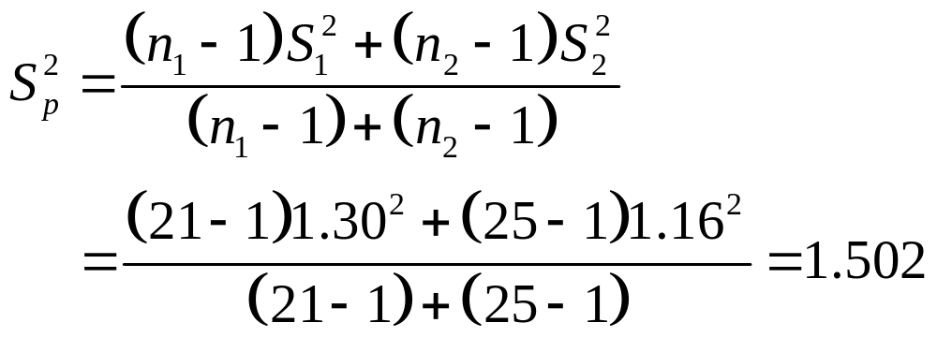
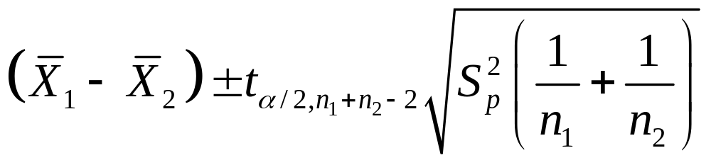
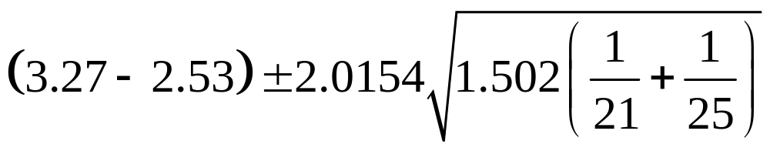
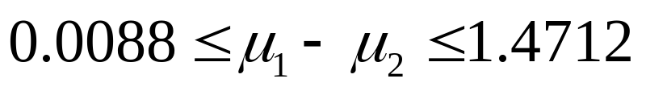
Example: Solution

Slide 19

Solution in Excel
An Excel Spreadsheet with the Solution:

Slide 20
F Test for Difference in Two Population Variances
Test for the Difference in 2 Independent Populations
Parametric Test Procedure
Assumptions
  Both populations are normally distributed
    Test is not robust to this violation
  Samples are randomly and independently drawn

Slide 21
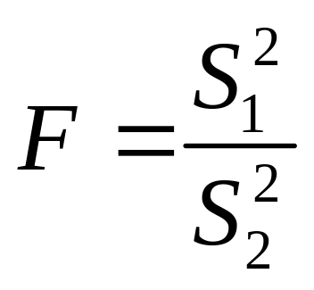
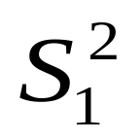

The F Test Statistic
= Variance of Sample 1
n₁ - 1 = degrees of freedom
= Variance of Sample 2
n₂ - 1 = degrees of freedom
0
F

Slide 22
Developing the F Test
Hypotheses
  H₀: σ₁² = σ₂²
  H₁: σ₁² ≠ σ₂²
Test Statistic
  F = S₁² /S₂²
  Two Sets of Degrees of Freedom
    df₁ = n₁ - 1; df₂ = n₂ - 1
  Critical Values: F_{L( )} and F_{U( )}
  F_{L} = 1/F_{U}* (*degrees of freedom switched)
Reject H₀
Reject H₀
Do Not
Reject
α/2
α/2
0
F_{L}
F_{U}
F
n₁ -1, n₂ -1
n₁ -1 , n₂ -1

Slide 23
F Test: An Example
Assume you are a financial analyst for Charles Schwab. You want to compare dividend yields between stocks listed on the NYSE & NASDAQ. You collect the following data:
NYSE NASDAQ
Number 21 25
Mean 3.27 2.53
Std Dev 1.30 1.16
Is there a difference in the variances between the NYSE & NASDAQ at the α = 0.05 level?
© 1984-1994 T/Maker Co.

Slide 24
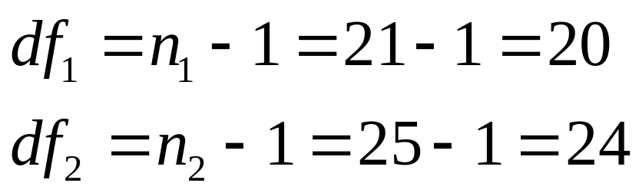
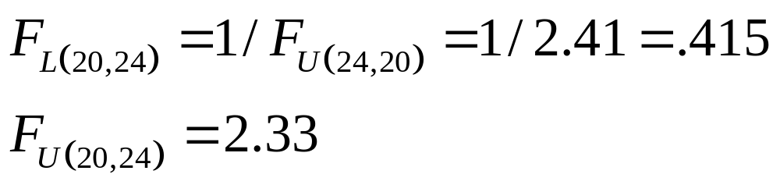
F Test: Example Solution
Finding the Critical Values for α = .05

Slide 25
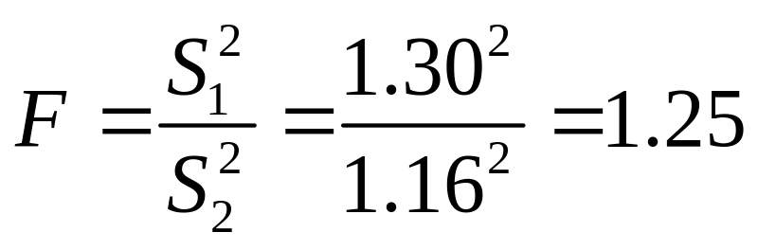
F Test: Example Solution
Test Statistic:
Decision:
Conclusion:
H₀: σ₁² = σ₂²
H₁: σ₁² ≠ σ₂²
α = .05
df₁ = 20 df₂ = 24
Critical Value(s):
Reject
Reject
Do not reject at α = 0.05.
.025
.025
There is insufficient evidence to prove a difference in variances.
0
0.415
2.33
F
1.25

Slide 26
F Test in PHStat
PHStat | Two-Sample Tests | F Test for Differences in Two Variances
Example in Excel Spreadsheet

Slide 27
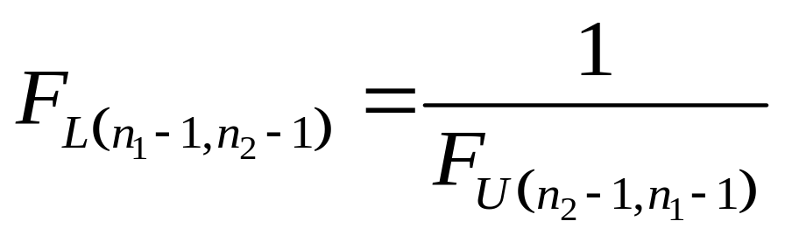
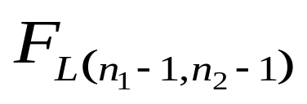
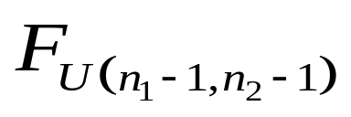
F Test: One-Tail
H₀: σ₁² ≥ σ₂²
H₀: σ₁² ≤ σ₂²
or
  H₁: σ₁² < σ₂²
  H₁: σ₁² > σ₂²
α = .05
Degrees of freedom switched
Reject
Reject
α = .05
α = .05
0
F
0
F

Slide 28
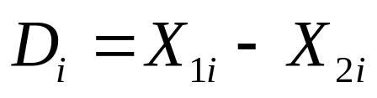
Comparing Two Related Samples
Test the Means of Two Related Samples
  Paired or matched
  Repeated measures (before and after)
  Use difference between pairs
Eliminates Variation between Subjects

Slide 29
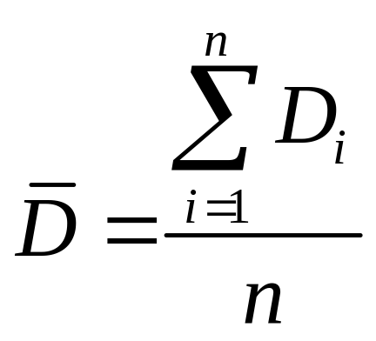
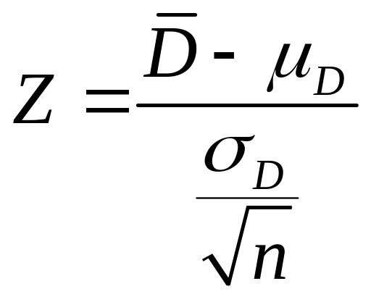
Z Test for Mean Difference (Variance Known)
Assumptions
  Both populations are normally distributed
  Observations are paired or matched
  Variance known
Test Statistic

Slide 30

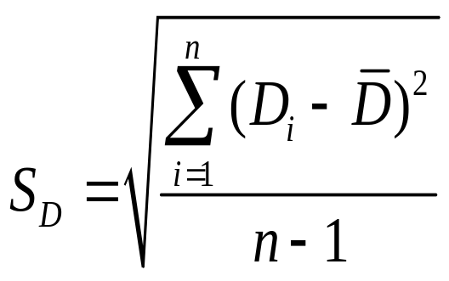
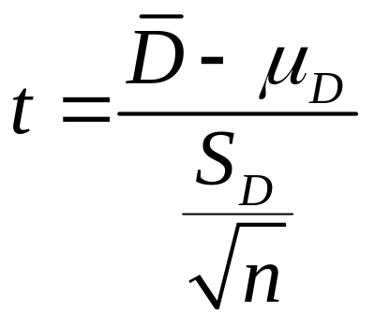
t Test for Mean Difference (Variance Unknown)
Assumptions
  Both populations are normally distributed
  Observations are matched or paired
  Variance unknown
  If population not normal, need large samples
Test Statistic

Slide 31

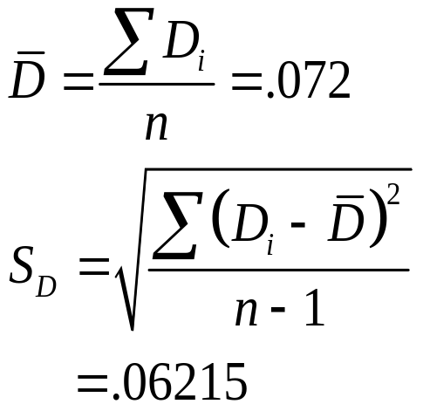
Paired-Sample t Test: Example
Assume you work in the finance department. Is the new financial package faster (α=0.05 level)? You collect the following processing times:
User Existing System (1) New Software (2) Difference D_{i}
C.B. 9.98 Seconds 9.88 Seconds .10
T.F. 9.88 9.86 .02
M.H. 9.84 9.75 .09
R.K. 9.99 9.80 .19
M.O. 9.94 9.87 .07
D.S. 9.84 9.84 .00
S.S. 9.86 9.87 - .01
C.T. 10.12 9.98 .14
K.T. 9.90 9.83 .07
S.Z. 9.91 9.86 .05

Slide 32

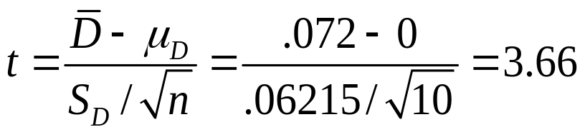
Paired-Sample t Test: Example Solution
Is the new financial package faster (0.05 level)?
H₀: μ_{D} ≤ 0
H₁: μ_{D} > 0
Reject
α =.05
D =
.072
α =.05
Critical Value=1.8331 df = n - 1 = 9
1.8331
3.66
Decision: Reject H₀
t Stat. in the rejection zone.
Test Statistic
Conclusion: The new software package is faster.

Slide 33

Paired-Sample t Test in
Excel
Tools | Data Analysis… | t test: Paired Two Sample for Means
Example in Excel Spreadsheet

Slide 34

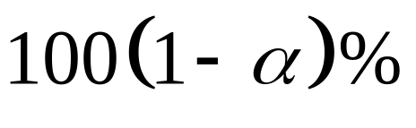
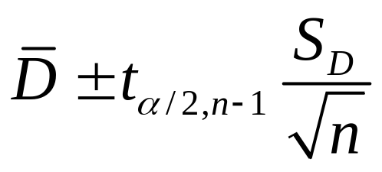
Confidence Interval Estimate for of Two Related Samples
Assumptions
  Both populations are normally distributed
  Observations are matched or paired
  Variance is unknown
Confidence Interval Estimate:

Slide 35
Example
Assume you work in the finance department. You want to construct a 95% confidence interval for the mean difference in data entry time. You collect the following processing times:
User Existing System (1) New Software (2) Difference D_{i}
C.B. 9.98 Seconds 9.88 Seconds .10
T.F. 9.88 9.86 .02
M.H. 9.84 9.75 .09
R.K. 9.99 9.80 .19
M.O. 9.94 9.87 .07
D.S. 9.84 9.84 .00
S.S. 9.86 9.87 - .01
C.T. 10.12 9.98 .14
K.T. 9.90 9.83 .07
S.Z. 9.91 9.86 .05

Slide 36
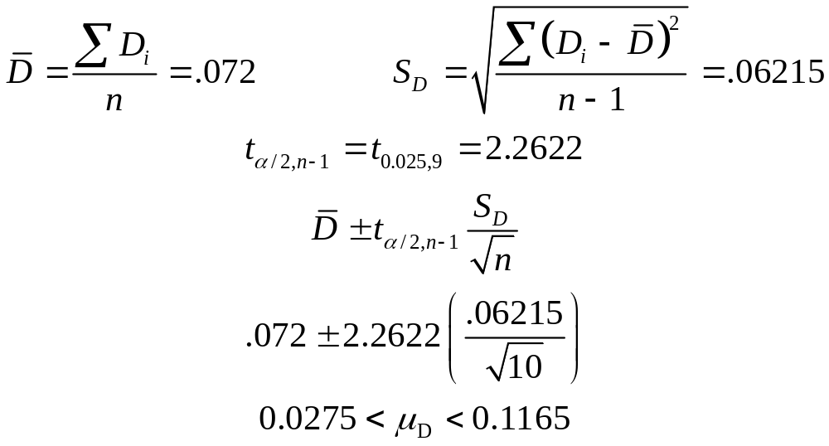
Solution:

Slide 37
Wilcoxon Rank Sum Test for Differences in 2 Medians
Test Two Independent Population Medians
Populations Need Not Be Normally Distributed
Distribution Free Procedure
Used When Only Rank Data is Available
Can Use Normal Approximation if n_{j} >10 for at least One j

Slide 38
Wilcoxon Rank Sum Test: Procedure
Assign Ranks, R_{i} , to the n₁ + n₂ Sample Observations
  If unequal sample sizes, let n₁ refer to smaller-sized sample
  Smallest value R_{i} = 1
  Assign average rank for ties
Sum the Ranks, T_{j} , for Each Sample
Obtain Test Statistic, T₁ (Smallest Sample)

Slide 39
Wilcoxon Rank Sum Test:
Setting of Hypothesis
Two-Tail Test
Left-Tail Test
Right-Tail Test
H₀: M₁ = M₂
H₁: M₁ ≠ M₂
H₀: M₁ ≥ M₂
H₁: M₁ < M₂
H₀: M₁ ≤ M₂
H₁: M₁ > M₂
Reject
Do Not Reject
Reject
Reject
Do Not Reject
Do Not Reject
Reject
T_{1L}
T_{1U}
T_{1L}
T_{1U}
M₁ = median of population 1
M₂ = median of population 2

Slide 40
Wilcoxon Rank Sum Test: Example
Assume you’re a production planner. You want to see if the median operating rates for the 2 factories is the same. For factory 1, the rates (% of capacity) are
71, 82, 77, 92, 88. For factory 2,
the rates are 85, 82, 94 & 97.
Do the factories have
the same median rates
at the 0.10 significance level?

Slide 41
Wilcoxon Rank Sum Test:
Computation Table
Factory 1
Factory 2
Rate
Rank
Rate
Rank
71
1
85
5
82
Tie
3
3.5
82
Tie
4
3.5
77
2
94
8
92
7
97
9
88
6
...
...
Rank Sum
T₂=19.5
T₁=25.5

Slide 42
Lower and Upper Critical Values T₁ of Wilcoxon Rank Sum Test
n₂ | α |  | n₁
 | One-Tailed | Two-Tailed | 4 | 5
4
5 | .05 | .10 | 12, 28 | 19, 36
 | .025 | .05 | 11, 29 | 17, 38
 | .01 | .02 | 10, 30 | 16, 39
 | .005 | .01 | --, -- | 15, 40
6

Slide 43
Wilcoxon Rank Sum Test:
Solution
H₀: M₁ = M₂
H₁: M₁ ≠ M₂
α = .10
n₁ = 4 n₂ = 5
Critical Value(s):
Test Statistic:
Decision:
Conclusion:
T₁ = 5 + 3.5 + 8+ 9 = 25.5 (Smallest Sample)
Do not reject at α = 0.10.
Do Not Reject
There is no evidence medians are not equal.
Reject
Reject
12
28

Slide 44
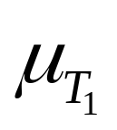
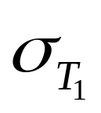
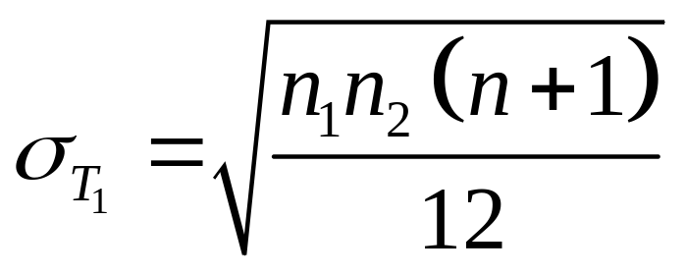
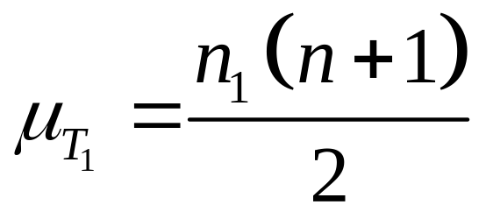
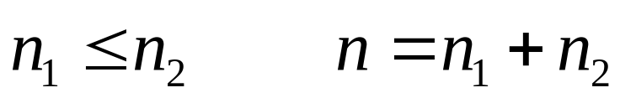
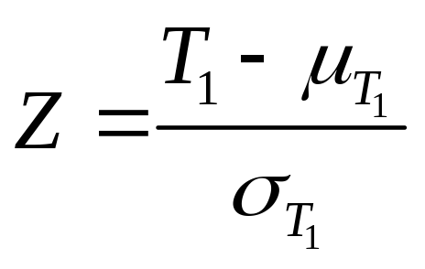
Wilcoxon Rank Sum Test
(Large Sample)
For Large Sample, the Test Statistic T₁ is Approximately Normal with Mean and Standard Deviation
Z Test Statistic

Slide 45
Wilcoxon Signed Ranks Test
Used for Testing Median Difference for Matched Items or Repeated Measurements When the t Test for the Mean Difference is NOT Appropriate
Assumptions:
  Paired observations or repeated measurements of the same item
  Variable of interest is continuous
  Data are measured at interval or ratio level
  The distribution of the population of difference scores is approximately symmetric

Slide 46

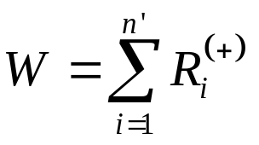
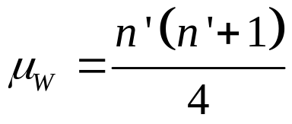
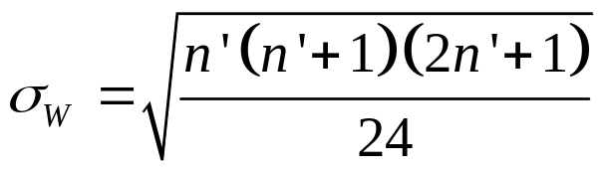
Wilcoxon Signed Ranks Test: Procedure
Obtain a difference score D_{i} between two measurements for each of the n items
Obtain the n absolute difference |D_{i} |
Drop any absolute difference score of zero to yield a set of
n’ n
Assign ranks R_{i} from 1 to n’ to each of the non-zero |D_{i} |; assign average rank for ties
Obtain the signed ranks R_{i}⁽⁺⁾ or R_{i}⁽⁻⁾ depending on the sign of D_{i}
Compute the test statistic:
If n’ 20, use Table E.9 to obtain the critical value(s)
If n’ > 20, W is approximated by a normal distribution with

Slide 47
Wilcoxon Signed Ranks Test: Example
Assume you work in the finance department. Is the new financial package faster (α=0.05 level)? You collect the following processing times:
User Existing System (1) New Software (2) Difference D_{i}
C.B. 9.98 Seconds 9.88 Seconds .10
T.F. 9.88 9.86 .02
M.H. 9.84 9.75 .09
R.K. 9.99 9.80 .19
M.O. 9.94 9.87 .07
D.S. 9.84 9.84 .00
S.S. 9.86 9.87 - .01
C.T. 10.12 9.98 .14
K.T. 9.90 9.83 .07
S.Z. 9.91 9.86 .05

Slide 48
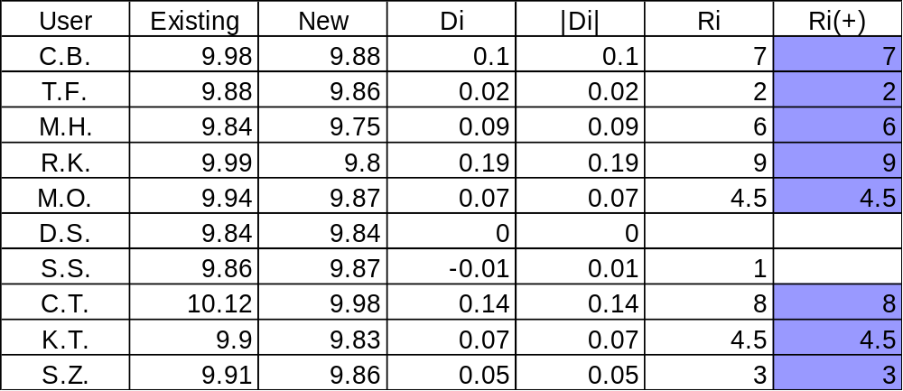
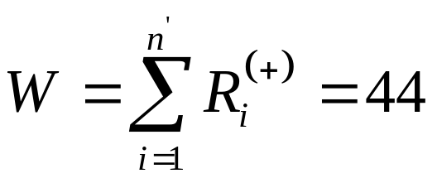
Wilcoxon Signed Ranks Test: Computation Table

Slide 49
Upper Critical Value of Wilcoxon Signed Ranks Test
n | ONE-TAIL α = 0.05 TWO-TAIL α = 0.10 | α = 0.025 α = 0.05
(Lower, Upper)
9 | 8,37 | 5,40
10 | 10,45 | 8,47
11 | 13,53 | 10,56
Upper critical value (W_{U} = 45)

Slide 50

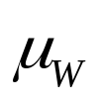


Wilcoxon Signed Ranks Test:
Solution
Test Statistic:
Decision:
Conclusion:
H₀: M₁ M₂
H₁: M₁ > M₂
α = .05
n = 10
Critical Value:
W = 44
Do not reject at α = 0.05.
Reject
There is no evidence the median difference is greater than 0. There is not enough evidence to conclude that the new system is faster.
.05
0
+Z

Slide 51
Chapter Summary
Compared Two Independent Samples
  Performed Z test for the differences in two means
  Performed t test for the differences in two means
Addressed F Test for Difference in Two Variances
Compared Two Related Samples
  Performed paired sample Z tests for the mean difference
  Performed paired sample t tests for the mean difference

Slide 52
Chapter Summary
(continued)
Addressed Wilcoxon Rank Sum Test
  Performed tests on differences in two medians for small samples
  Performed tests on differences in two medians for large samples
Illustrated Wilcoxon Signed Ranks Test
  Performed tests for median differences for paired observations or repeated measurements

